Slide 1
Introductory General Chemistry
Chemistry 3A
In-Person Lab Session Tasks & Activities
Mitch Halloran

Slide 2
Summer 2026 Experiment Schedule
When | What | Safety
Week 1, Wednesday | Expt 1a – Measurements | Yes
Week 1, Thursday | Expt 2a – Atomic Mass | No
Week 2, Tuesday | Expt 5a – Empirical Formula | Yes
Week 2, Wednesday | Expt 7a – Calorimetry | Yes
Week 2, Thursday | Expt 8a – Gas Consant R | Yes
Week 3, Tuesday | Expt 9a – Solutions & Dilutions | Yes
Week 3, Wednesday | Expt 10a – Types of Reactions | Yes
Week 3, Thursday | Expt 11a – Alum Synthesis | Yes
Week 4, Tuesday | Expt 12a – Household Items pH | Yes
Week 4, Wednesday | Expt 12b – Citric Acid Determination | Yes

Slide 3
The Daily Academic Routine
Asynchronous
Lecture videos
Homework
Notetaking / Participation
Reading Lab Manual for Day’s Experiments
Pre-Lab Quiz (before lab)!
In-Person
Experiment Day or Exam Day

Slide 4
Course Pages
Dr Mushibe’s course chapters start here
Links to all assignments in the page for each chapter
Click Next and Back on page to move around
Due dates?
Check Canvas Modules
You might reference this daily modularized schedule in Excel too

Slide 5
Typical Lab Session Day
On days when an experiment is done
We have 2.5 hours to get all this done
  20 min shorter than in 18-week semester
Read the Lab Manual for the experiment:
  15-30 min preparation for the quiz and the lab
Make sure you do the MOM Pre-Lab Quiz before coming to lab
  Do not do the quiz without reading prep: there are penalties on points if you just guess several times. Comprehend first, then you have success in acing the quiz all the time

Slide 6
Typical Lab Session Day
At the lab:
Partner
  Teams get things done better than loners
  Find a partner (teams of two, not three or more!!)
  Because of absences/drops, your partner might change
  I normally take a lot of points off report if no partner name in the handwritten submission
10 min intro by me (hopefully)
  I give you summary, instructions & hints not always found in the manual to help you get through the experiment efficiently, with hope you understand stuff

Slide 7
Typical Lab Session Day
Your turn
Go to work
You and your partner divide labor except for all measurements
Do the experimental work
Use both electronic (MyOpenMath) form and Handwritten pages in preparing your report
The pages of your handwritten report must be imaged clearly and bound to a PDF.

Slide 8
Measurements
About Measurements
These are the numbers and units that go in your DATA entries/tables
Measurements are data from equipment, masses on the balance, reading volumes on volumetric devices, lengths on a ruler
You are your partner do measurements together! Partners verify.
About Calculations
math operations you do on measurements which includes conversion factors and constants of nature

Slide 9
Precision
You start learning chemistry by understanding its math
You must quickly learn
Scientific notation
  it can help you understand precision
Significant digits (a/k/a significant figures)
Decimal places
PEMDAS in operations
Precision of your quantities will be required from the very start

Slide 10
Using Balances
You get masses in the use of balances
TARING (ZEROING) CONTAINERS
  Put the clean container or weighing glassine paper on the balance
  Close the glass doors (all of them)
  Press “Tare” or “Zero”. Wait for it to stabilize
  Scoop/add your compound to the paper/container
  Close the door
  Wait for balance to stabilize. It will usually lock the value
Halloran Convention: always re-do the last measurement (not scooping) to verify it. It’s quick and free
EXCEPTIONS ON TARING CONTAINERS
  Sometimes the lab manual will have you get the mass of the empty container. In this case, tare the balance with nothing on the platform. Then add compound to container, tare the balance again, get the mass of compound + container

Slide 11
Balance Care
This is just an FYI: Your instructor should ensure balances are level, make any needed adjustments
For balances to work properly, they must be level
Balances include a level with a bubble that must be centered
The feet of the balance have screws that can be turned to ensure the level bubble is centered
Before leveling, position the balance to where it is comfortable to use on the bench, not too far from the edge of table, and not too close

Slide 12
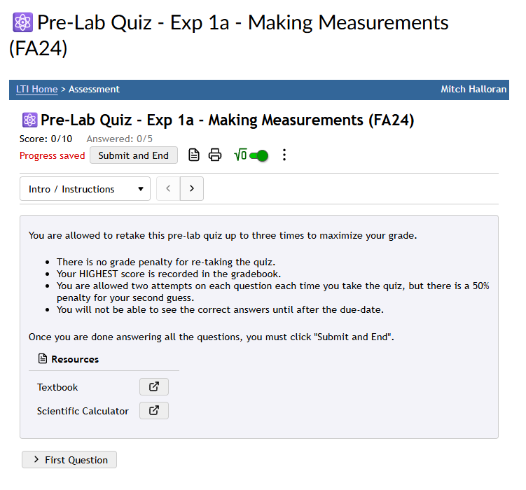
Pre-Lab Quiz
Make sure you have read the lab manual for the experiment you will do this day.
It has the info to correctly answer the questions
You must score a minimum number of points to gain access to the lab’s Data Report
You should complete the quiz BEFORE you come to lab session

Slide 13
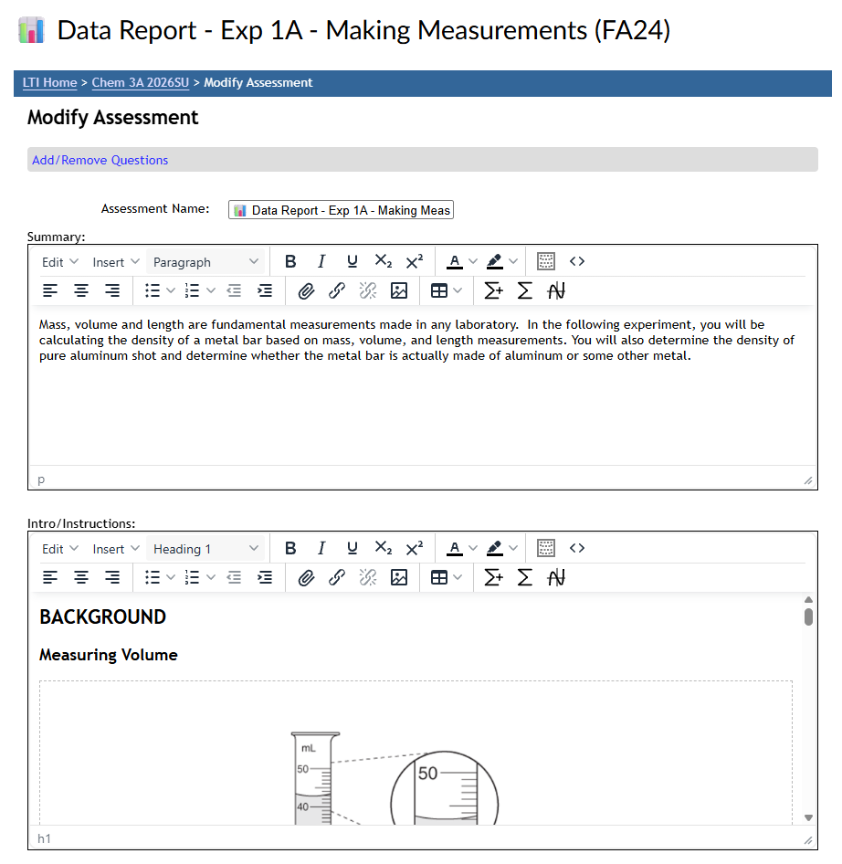
Experiment Data Report
The MyOpenMath assessment which is the “Data Report” should be utilized during the lab session.
It helps you correctly record your values (numbers + units) with the correct precision.
Complete your handwritten entries in the lab manual together with using the MOM online form
Reports are due before end of day

Slide 14
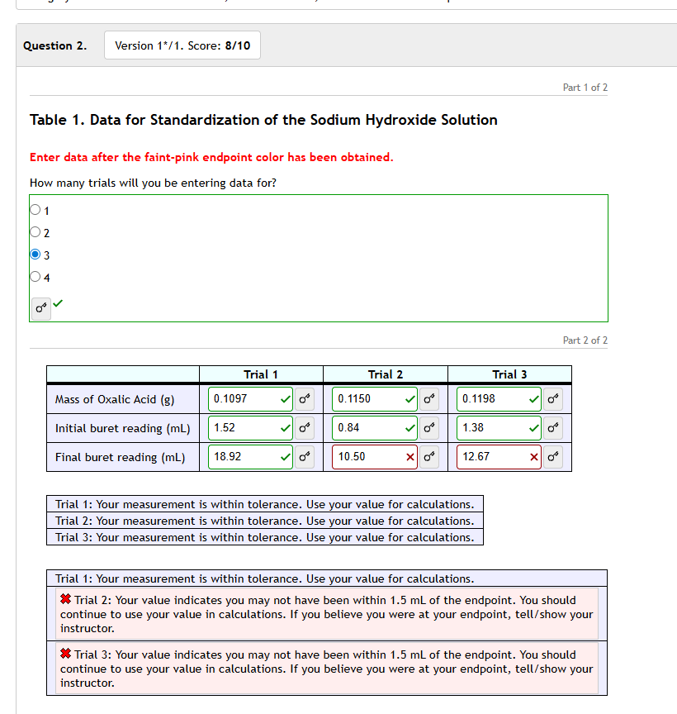
Green Checkmarks and Red Xes
  You get green checkmarks when the MyOpenMath tool evaluates your entries with
    Expected values for measurements and calculations
    All your values have correct precision and units, when units are to be entered
  If you get red Xes, look for a small popup message indicating what is expected
    Ask instructor for assistance as a last resort

Slide 15
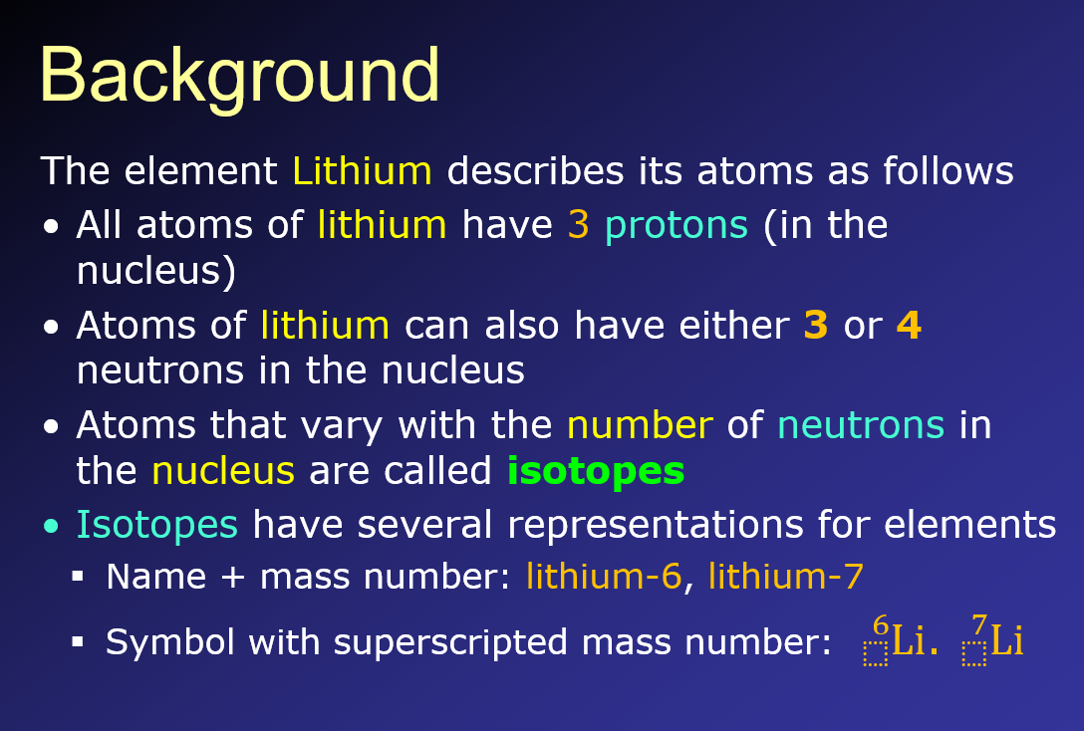
My Lab Session PowerPoint Intros
  For each lab session with experiments, I prepare a PowerPoint intro which I hope gets you revved up and efficiently moving
  I start with a Background

Slide 16
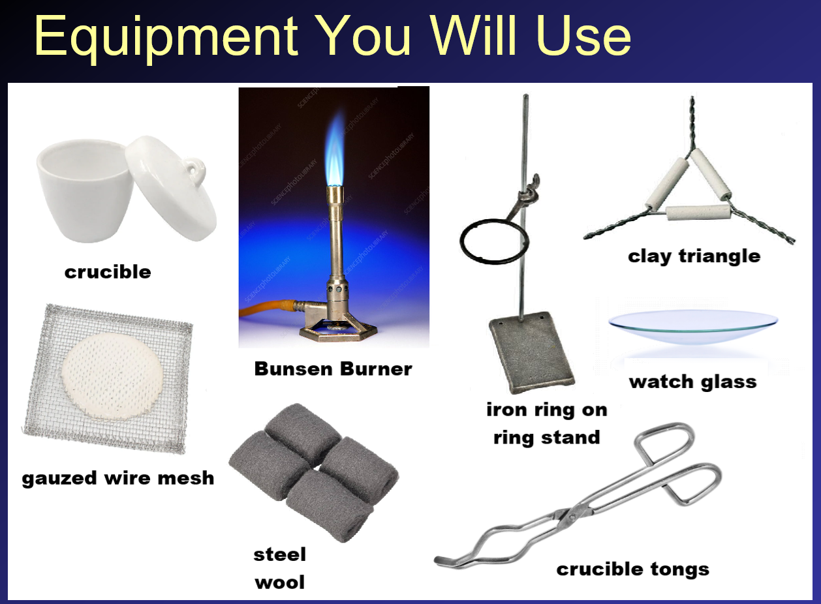
My Lab Session PowerPoint Intros
  A visual of the
  Equipment and Consumables You Will Use
  might help

Slide 17
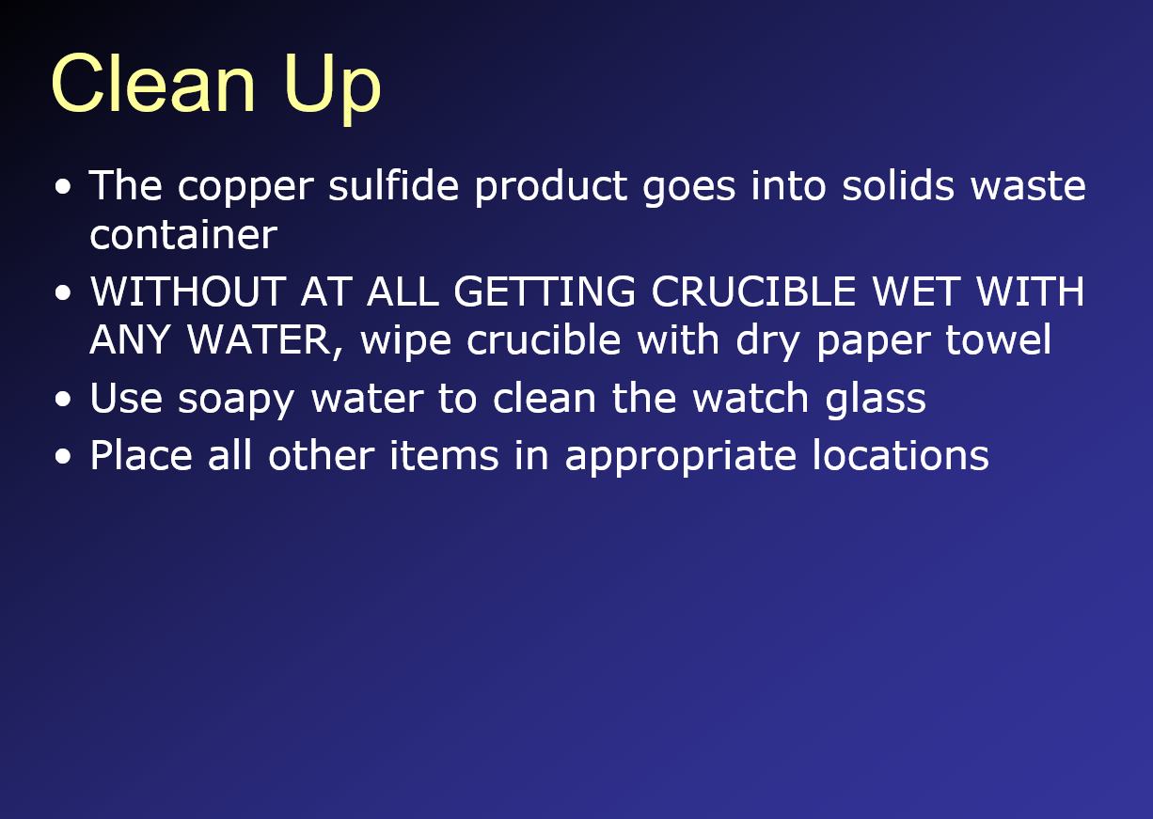
My Lab Session PowerPoint Intros
  All laboratory work must keep in mind
  that there is Clean Up

Slide 18
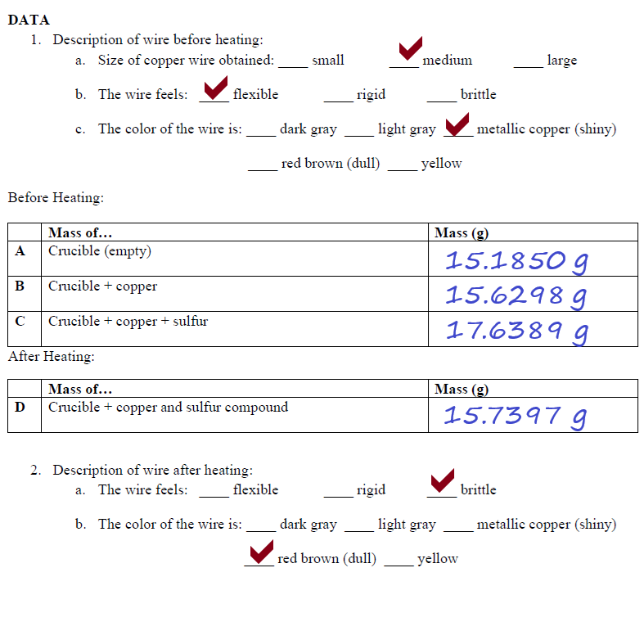
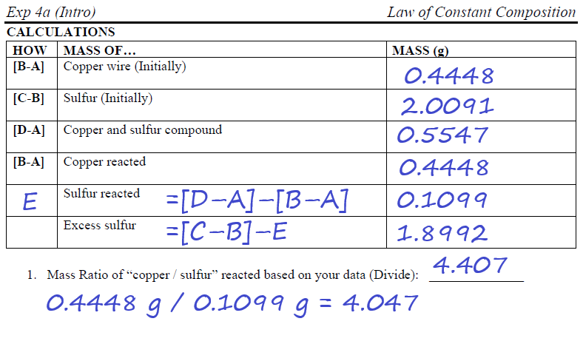
My Lab Session PowerPoint Intros
  Sometimes included is an Example Data Analysis to be used as a guide for the proper completion of the handwritten part of your report. Your handwritten report is guided also by MyOpenMath tool so you correctly create the report.

